Slide 1


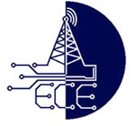
Real-Time Mobile Phone Usage Detection and Automated Ticketing Using YOLO Deep Learning Algorithm
Department of
ELECTRONICS AND COMMUNICATION ENGINEERING
Guided by
DR.C.KUMAR, Ph.D
Presented by
M.VAMSI KRISHNA : 21691A04Q9
P.VENU KUMAR : 21691A04R9
M.VISHNUVARDHAN : 21691A04T0

Slide 2
Abstract
Mobile phone usage by two-wheeler riders significantly increases the risk of road accidents and violates traffic regulations. This paper proposes a real-time system for detecting mobile phone usage among two-wheeler riders and automating the ticketing process using the YOLO deep learning algorithm. A custom dataset was developed with annotated images of two-wheeler riders, both with and without mobile phone usage. The YOLOv8 model was trained and deployed on a Raspberry Pi platform to enable portable, real-time detection. The system captures the violation, extracts the vehicle's number plate using Optical Character Recognition (OCR), and generates an automated e-ticket. Experimental results demonstrate that the proposed model achieves a mean Average Precision (mAP) of 92.7% at IoU=0.5, ensuring high detection accuracy in diverse real-world conditions. This work contributes a costeffective, scalable solution for enhancing traffic law enforcement and improving road safety

Slide 3
Literature Survey
Title: Real-Time Vehicle Detection Using YOLO v8 Model
Author: Dr G Paavai Anand, M. A. Saianuush, Moomal Arshth, Sanjay. S
Abstract: This paper explores the application of the YOLOv8 model for real-time vehicle detection. The primary objective is to enhance detection accuracy and speed, focusing on the effectiveness of the YOLOv8 architecture in identifying vehicles within camera feeds. Key metrics such as Mean Squared Error (MSE), Root Mean Squared Error (RMSE), and detection accuracy are used to evaluate model performance. Our findings demonstrate that YOLOv8 provides high detection accuracy and speed, making it suitable for realworld applications in adaptive signal control, prioritizing efficient vehicle detection

Slide 4
Introduction
This project introduces an innovative real-time system designed to detect mobile phone usage by two-wheeler drivers and automate the ticketing process, leveraging YOLO (You Only Look Once) and a Raspberry Pi. The system captures live video footage of the driver using a USB web camera and processes it through YOLO for real-time analysis to identify mobile phone usage. Once a violation is detected, the system retrieves vehicle information by scanning and extracting the number plate details using Tesseract OCR. An LCD display is used to present relevant information to the operator. This automated solution aims to enhance road safety by promptly identifying distracted driving behaviors and issuing tickets efficiently.

Slide 5
Proposed Method
The proposed method utilizes a real-time system powered by YOLO for detecting mobile phone usage by two-wheeler drivers. A USB web camera captures video of the driver, while YOLO analyzes the footage in real time to identify phone usage. Once a violation is detected, the system uses Tesseract OCR to scan and extract the vehicle’s number plate information. This fully automated system ensures timely ticket issuance without the need for human intervention. By integrating real-time video analysis with automated number plate recognition and ticketing, the system significantly enhances road safety and improves the efficiency of monitoring distracted driving.

Slide 6
Existing Method
Existing methods for detecting mobile phone usage by drivers primarily rely on manual enforcement or stationary cameras with limited real-time analysis. These systems often require human intervention to monitor footage and issue tickets, making the process time-consuming and inefficient. Additionally, they struggle with accurately detecting mobile phone usage due to inconsistent analysis of driver actions and an inability to process video feeds in real time. Environmental challenges, such as varying lighting conditions and different camera angles, further reduce detection accuracy. Furthermore, many existing systems lack automated ticketing integration, resulting in delays in fine issuance and reduced overall effectiveness.

Slide 7
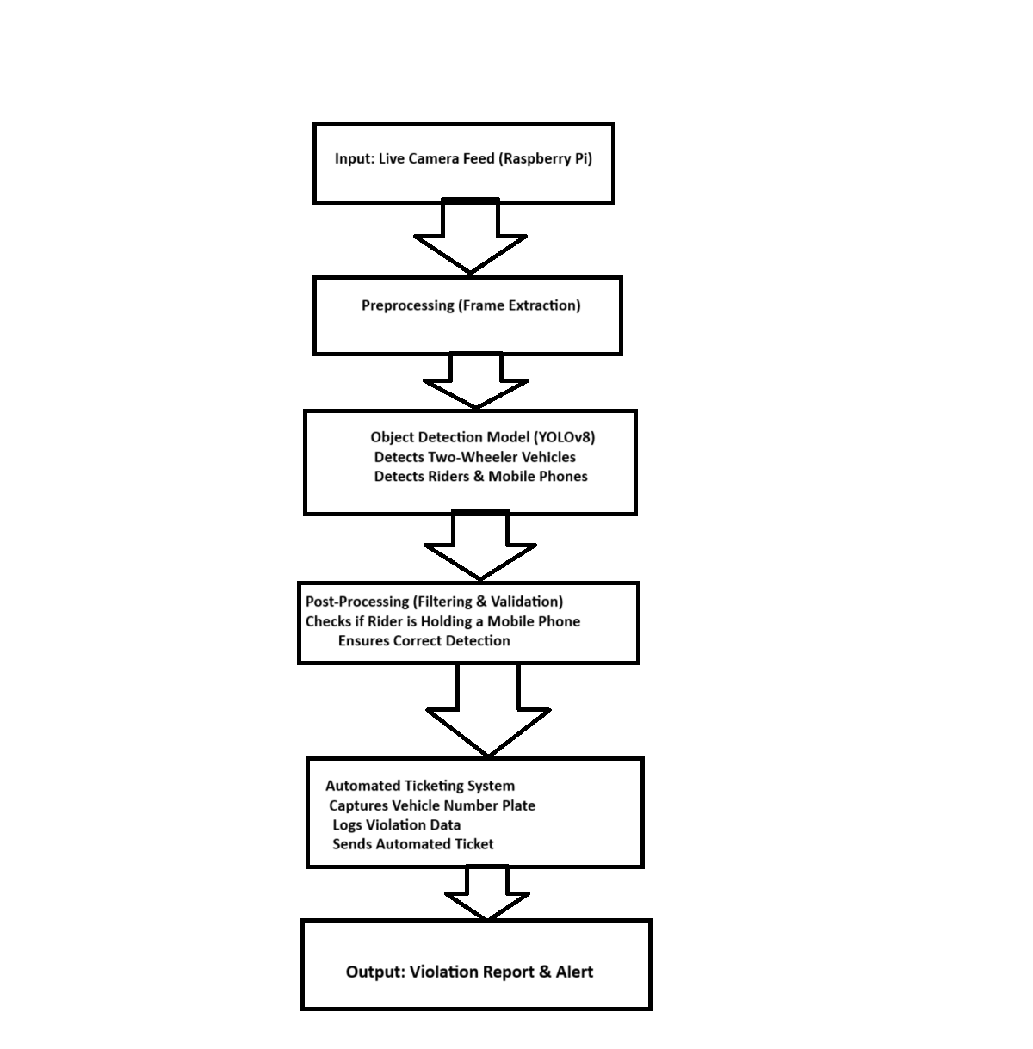
Yolo v8 block diagram

Slide 8
Explanation
Explanation of Each Block
Input (Live Camera Feed from Raspberry Pi)
The system captures a continuous video feed from a camera mounted on a traffic pole or roadside to monitor vehicles.
Preprocessing (Frame Extraction & Enhancement)
Extracts frames from the video feed.
Enhances images for better detection accuracy.
YOLOv8 Object Detection
Two-wheeler detection: Identifies motorcycles and scooters on the road.
Mobile phone detection: Identifies if the rider is using a mobile phone while driving.

Slide 9
Explanation
Post-Processing (Filtering & Validation)
Filters false positives using spatial relationships and confidence thresholds.
Ensures detected mobile phone is in the rider's hand, not in a pocket or on the vehicle.
Automated Ticketing System
Number Plate Recognition (Using SSD or OCR techniques like Tesseract)
Violation Logging: Stores the detected violation in a database with timestamp, vehicle number, and location.
Alert Generation: Sends an automated fine or warning message to the vehicle owner.
Output (Violation Report & Alert)
The detected violations are logged, and necessary authorities or the violator receive notifications

Slide 10
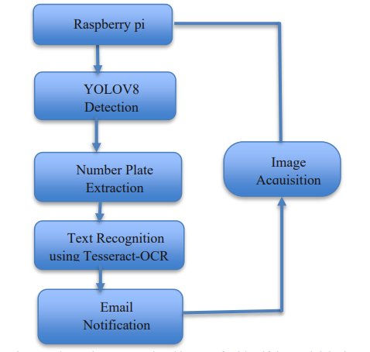
System Architecture

Slide 11
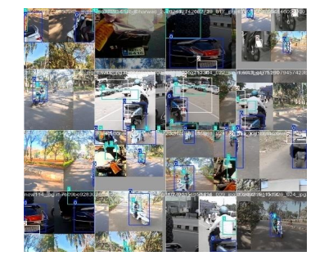
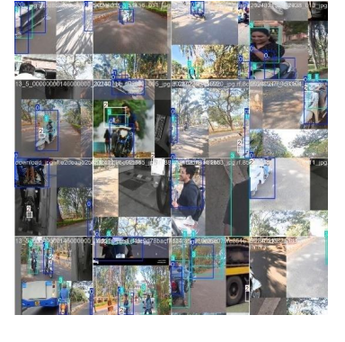
Trained Dataset Sample Images

Slide 12
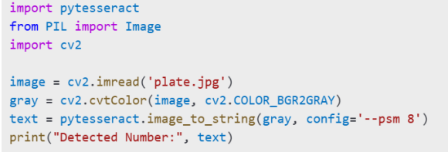
Python Code to Detect Number Plate

Slide 13
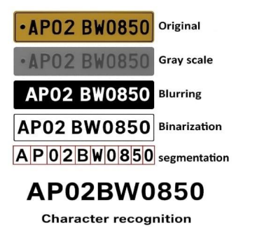
Number Plate Recognition
Using Tesseract OCR

Slide 14
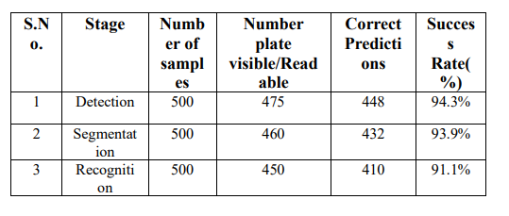
Number Plate Detection Outcome
on Dataset

Slide 15
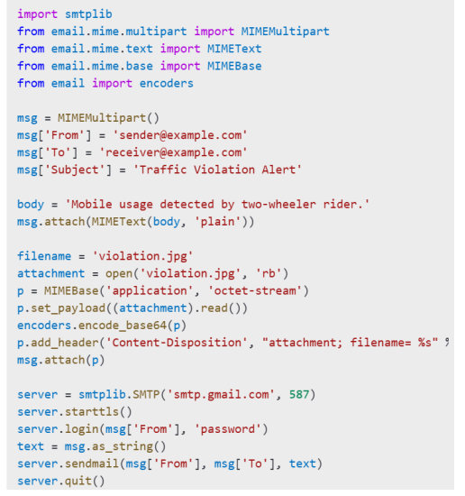
Python Code to send Email

Slide 16
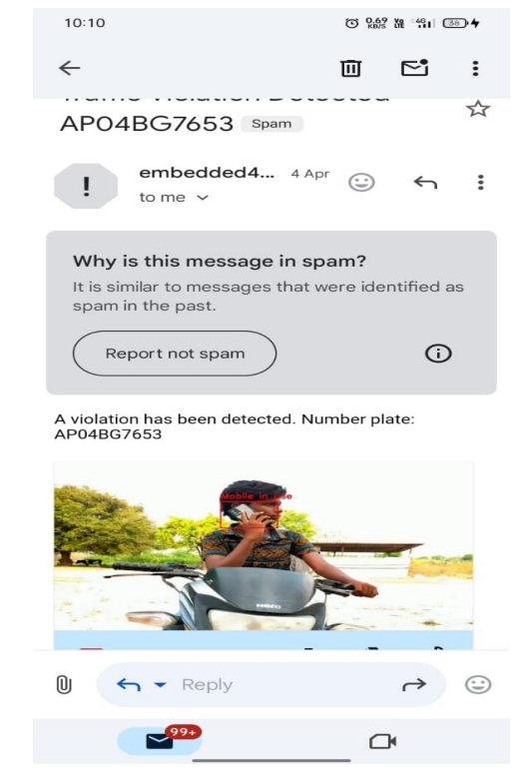
Output Email

Slide 17
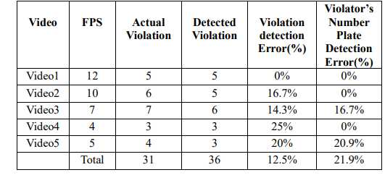
Evaluation of detection and OCR
performance over video sequences

Slide 18
Advantages and Applications
Advantages
Applications
• - Real-time
• - Automated
• - Efficient
• - Accurate
• - Road safety
• - Traffic monitoring
• - Vehicle enforcement
• - Automated ticketing

Slide 19
References
1. Redmon, J., Divvala, S., Girshick, R., & Farhadi, A. (2016). *You Only Look Once: Unified, Real-Time Object Detection*. In Proceedings of the IEEE Conference on Computer Vision and Pattern Recognition (CVPR), 779-788.
2. Zhang, Y., & Xie, L. (2019). *Real-time Object Detection for Mobile Applications Using YOLO*. International Journal of Computer Science and Information Security, 17(4), 23-29.
3. Kumar, A., & Singh, V. (2021). *Mobile Phone Detection for Traffic Safety Using Machine Learning*. Journal of Traffic Safety and Technology, 34(2), 123-132.

Slide 20
Conclusion
In conclusion, this project introduces an automated system that enhances road safety by detecting mobile phone usage among two-wheeler drivers in real time. By leveraging YOLO on a Raspberry Pi and integrating a USB camera with Tesseract OCR for number plate recognition, the system efficiently identifies distracted drivers and automates the ticketing process. The inclusion of an LCD display for presenting information, along with automated number plate extraction, ensures accurate and timely enforcement, contributing to safer driving behaviors and improved road safety.

